Slide 1
SQL Injection and Prevention.
1

Slide 2
Hello!
I am Kedar Jadhav
2

Slide 3
Title
Basic of SQL
SQL Injection
SQL Injection Attack Types
Example Website
Real World Examples
Prevention of SQL Injection Attack
3

Slide 4
SQL
SQL (Structured Query Language) is a domain-specific language used in programming and designed for managing data held in a relational database management system (RDBMS).
SQL was initially developed at IBM by Donald D and Raymond F. Boyce in the early 1970s. It was created for getting access and modifying data held in databases.
The scope of SQL include data insert, query, update and delete, schema creation and modification and data access control.
Microsoft SQL server, RazorSQL, MySQL, Oracle SQL Developer, Toad are some of the best SQL IDEs are available.
4

Slide 5
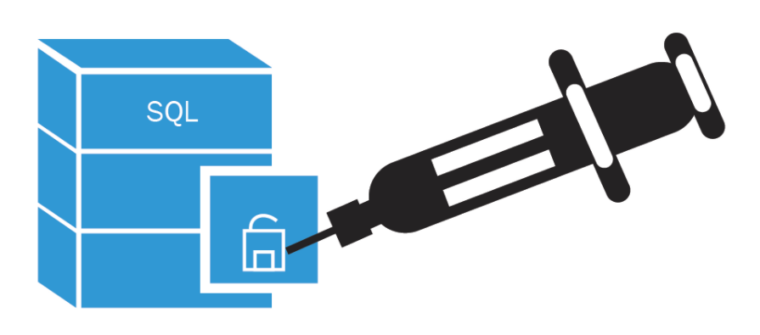
SQL Injection
Many web applications take user input from a form
Often this user input is used literally in the construction of a SQL query submitted to a database. For example:
SELECT productdata FROM table WHERE productname = ‘user input product name’;
A SQL injection attack involves placing SQL statements in the user input, there by gaining unauthorized access to databases in order to view or manipulate restricted data.
5

Slide 6
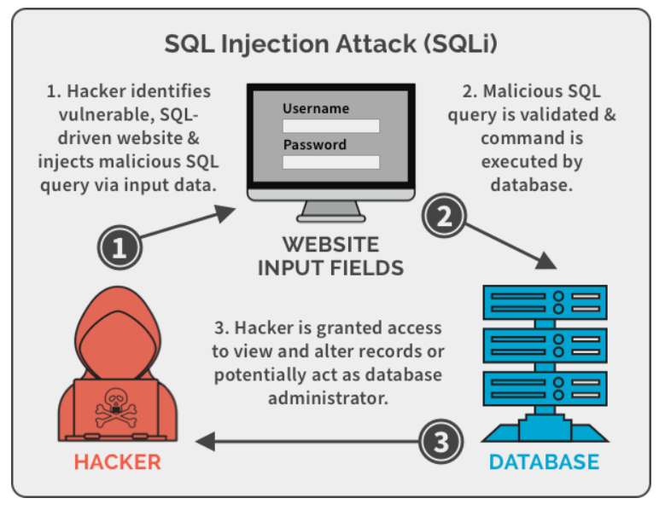
SQL Injection Attack
SQL injection vulnerabilities are the combining of data and code in dynamic SQL statement, error revelation, and the insufficient input validation.
6

Slide 7
SQL Injection
Application security weakness that allows
attackers to control an application’s
database by.
1
2
3
4
Letting them access
Delete Data
Changing an
application’s data driven
Tricking the
application Into
sending unexpected
SQL commands
7

Slide 8
Types of SQL Attacks
In-band SQLi:- The attacker gathers their results using the same communication channel they use to launch attacks.
Inferential SQLi:- In a Blind SQL injection technique, the hacker sends malicious data payloads, then reconstructs the database server’s structure using the web application’s response.
Out-of-Band SQLi:- The attacker uses the same channel to launch the attack and gather results. While this attack is uncommon since it relies on certain database server features being enabled.
8

Slide 9
Injection Mechanism
Injection involves -
Injection through user input
Injection through cookies
Injection through server variables
Inferential SQLi injection involves – Content based and Time-based SQLi. The attacker submits a second (different) request. To handle the second request, causing the attackers injected SQL query to execute.
9

Slide 10
Attack Intent
Adding or Modifying data
Add new data to the database,
Perform an INSERT in the injected SQL
Bypassing authentication
Alter passwords or permissions
A
B
Determining database schema
Modify stored procedures, functions, or other database schemas
Extracting data
Existing database or server objects, such as tables or users details
D
E
10

Slide 11
SQL injection tools
SQLMap - This tool makes it easy to exploit the SQL injection vulnerability of a web application and take over the database server.
SQLSus - SQLSus is another open source SQL injection tool and is basically a MySQL injection and takeover tool.
SQLninja - SQLninja is a SQL injection tool that exploits web applications that use a SQL server as a database server.
Safe3 SQL injector - Like other SQL injection tools, it also makes the SQL injection process automatic and helps attackers in gaining the access to a remote SQL server by exploiting the SQL injection vulnerability.
11

Slide 12
Other Injection Attacks
12

Slide 13
Example Website
SQL injection involves –
13

Slide 14
An Example SQL Injection Attack
All Queries are Possible:–
SELECT * FROM `login` WHERE `user`=‘’; INSERT INTO `login` ('user','pass') VALUES ('haxor','whatever');--’ AND `pass`=‘’
SELECT * FROM `login` WHERE `user`=‘’; UPDATE `login` SET `pass`=‘pass123’ WHERE `user`=‘timbo317’;--’ AND `pass`=‘’
SELECT * FROM `login` WHERE `user`=‘’; DROP TABLE `login`; --’ AND `pass`=‘’
14

Slide 15
A More Malicious Example
What if the attacker had instead entered:-
input‘; DROP TABLE login; --
Results in the following SQL:
SELECT * FROM login WHERE user = ‘ ’; DROP TABLE login; --’
Note how comment (--) consumes the final quote
Causes the entire database to be deleted
Depends on knowledge of table name
This is sometimes exposed to the user in debug code called during a database error.
15

Slide 16
Common SQL Injection URL Pattern
URL will not contain:-
ending with “--”
ending with “/*”
containing UNION, (ALL), SELECT statement and FROM
containing “Information_schema”
containing “load_file”
16

Slide 17
Real World Example
2019
Fortnite is an online game with over 350 million users. In 2019, a SQL injection vulnerability was discovered which could let attackers access user accounts.
2018
a SQL injection vulnerability was found in Cisco Prime License Manager. The vulnerability allowed attackers to gain shell access to systems on which the license manager was deployed.
2014
security researchers publicized that they were able to breach the website of Tesla using SQL injection, gain administrative privileges and steal user data.
2012
LinkedIn.com leaked 6.5 million user credentials. A class action lawsuit alleges that the attack was accomplished with SQL injection.
2009
The United States Justice Department charged an American citizen Albert Gonzalez and two unnamed Russians with the theft of 130 million credit card numbers using an SQL injection attack.
17

Slide 18
How does this prevent an attack?
The root cause of SQL injection vulnerabilities is insufficient input validation.
The SQL statement you pass to prepare is parsed and compiled by the database server.
By specifying parameters (either a ? or a named parameter like :name) you tell the database engine what to filter on.
Don’t store password in plain text in the DB
- salt them and hash them
18

Slide 19
More Defense
Check syntax of input for validity
Many classes of input have fixed languages
Verify that the input is a valid string in the language
Exclude quotes and semicolons
By specifying Have length limits on input
Many SQL injection attacks depend on entering long strings
Code reviews
19

Slide 20
Least privilege
To minimize the potential damage of a successful SQL injection attack, you should minimize the privilege assigned to every database accounts in your environment.
Do not assign DBA or admin type access rights to your application accounts.
Don’t run your DBMS as root or system.
Always enforce the constraint – Server side.
READ ONLY database access.
20

Slide 21
Quick Fixes
For companies that have a large setup or a lot of legacy code that will take a long time to audit and fix, put some SQL injection detection pattern in your Load Balancer itself.
Enable mod_security on Apache.
Run the RIPS scanner on your code for detecting vulnerabilities.
https://sourceforge.net/projects/rips-scanner/
https://resources.infosecinstitute.com/topic/rips-finding-vulnerabilities-php-application/
21

Slide 22
Thanks!

